Slide 1
Tulare Joint Union High School District
2018-2019 Budget
June 21, 2018
Presented by
Vivian Hamilton, Business Manager

Slide 2
GOALS OF BUDGET REPORT
Enrollment and Attendance Trends
Current Year Revenue and Expenditures
Local Control Funding Formula
Budget Priorities
Budget Assumptions
Multi-Year Projections
Next Steps

Slide 3
CALPADS and ADA
October 2015 – 5,360 students (+35)
October 2016 – 5,486 students (+126)
October 2017 – 5,544 students (+46)
OCTOBER 2018 – 5,544 STUDENTS (+0) (Estimate)
2015-2016 P2 ADA – 5,082 (Attendance Percentage 94.81% of 5,360)
2016-2017 P2 ADA – 5,195 (Attendance Percentage 94.69% of 5,486)
2017-2018 P2 ADA – 5,293 (Attendance Percentage 95.47% of 5,544)
2018-2019 p2 ada – 5,211 (ATTENDANCE PERCENTAGE ESTIMATED AT 94.00% OF 5,544)
A 1% increase in attendance equals $601,050 additional funding

Slide 4
2018-2019 BUDGET SUMMARY (Restricted & Unrestricted)

Slide 5
Projected Expenditures
Certificated Salaries $30,137,250
Classified Salaries $ 9,760,970
Employee Benefits, Certificated $13,932,698
Employee Benefits, Classified $ 5,990,460
Books & Supplies $ 3,721,797
Contracted Services & Operations $ 6,691,724
Capital Outlay $ 175,000
Other Outgo $ 960,551
Total Expenditures $71,370,450

Slide 6
Local Control Funding Formula
Factors | 9-12
Adjusted grant per ADA | $9,304
% Enrollment eligible | 73.98%
73.98% of Supplemental | $1,358
18.98% of Concentration (percentage above 55%) | $871
Total 2018-19 LCFF target grant per ADA | $11,533
Tulare Joint Union High School District – 2018-19
2018-19 LCFF Per ADA Funding | Projected 2018-19 ADA | Projected 2018-19 LCFF Total Revenue
$11,533 | 5,284 | $59,562,523

Slide 7
Budget Priorities
Staffing ratio at 25 to 1, not including Special Education
Student learning opportunities
Formula allocations increased in some areas due to input from Budget Advisory Committee
Local Control Accountability Plan (LCAP)
  All students will graduate college and career ready.
  All English Learners will improve their English Language Acquisition and achievement.
  All students will be part of a positive learning environment where they feel welcomed, valued, safe, and engaged as part of a greater community.

Slide 8
Budget Assumptions
No Enrollment growth
COLA 2.41%
Step & Column
Certificated staff growth (next slide)
Classified staff growth (next slide)
Increased employer costs for STRS and PERS

Slide 9

Growth Staffing
Certificated Staff
  Director of ag education (1.0 FTE) $153,510
  supervision (3.0 stipends) 7,830
  10 Math intervention Periods (1.67 FTE) 108,100
  Irc teacher (1.0 FTE) 102,440
  Psychologist (1.0 FTE) 141,800
  Teachers (2.0 fte) 143,600
  $ 657,280
Classified Staff
  Full-Time math intervention tutors (3.0 FTE) $130,200
  TOTAL $ 787,480

Slide 10
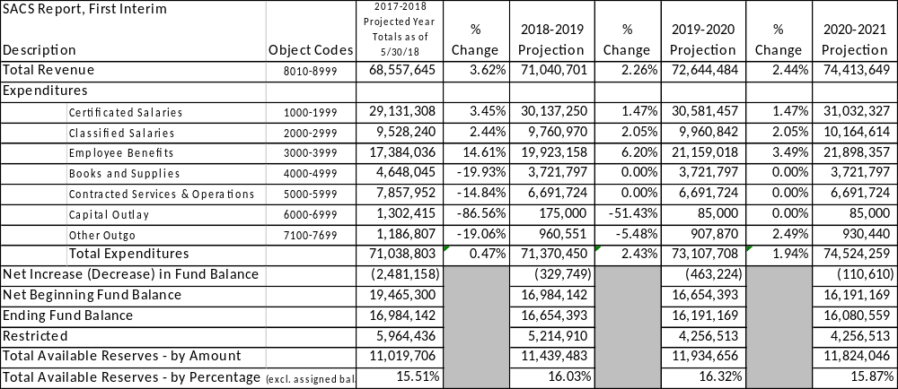
Multi-Year Projections

Slide 11
Next Steps
June 21, 2018
  Approve District’s 2018-2019 LCAP
  Approve Sierra Vista Charter’s 2018-2019 LCAP
  Approve Accelerated Charter’s 2018-2019 LCAP
  Approve 2018-2019 Budget
July 19, 2018
  Budget revisions after State budget is signed by Governor
  Update Board of Trustees
August 16, 2018
  Present prior year (unaudited) financial report to Board of Trustees
September 6, 2018
  Approve 2017-2018 unaudited financial report
  Update Board of Trustees
October 3, 2018
  CALPADS Day enrollment count
  Update Board of Trustees at October 4, 2018 meeting

Slide 12
Thank you to the Tulare Joint Union High School District
Board of Trustees
“Quality Schools Preparing Exceptional Students”
VISION: Our students will have the 21st Century skills and knowledge through meaningful and relevant learning opportunities to empower them to productively contribute to a global society.
MISSION: Our mission is to empower all students to graduate with college, career, and life-readiness skills.
EXPECTED GRADUATE OUTCOMES: Our students will…
> Think critically
> Work independently and collaboratively
> Communicate effectively
> Use creativity and imagination

